Slide 1
Data Mining:
Concepts and Techniques
— Slides for Textbook —
— Chapter 9 —
©Jiawei Han and Micheline Kamber
Intelligent Database Systems Research Lab
School of Computing Science
Simon Fraser University, Canada
http://www.cs.sfu.ca

Slide 2
Chapter 9. Mining Complex Types of Data
Multidimensional analysis and descriptive mining of complex data objects
Mining spatial databases
Mining multimedia databases
Mining time-series and sequence data
Mining text databases
Mining the World-Wide Web
Summary

Slide 3
Mining Complex Data Objects: Generalization of Structured Data
Set-valued attribute
  Generalization of each value in the set into its corresponding higher-level concepts
  Derivation of the general behavior of the set, such as the number of elements in the set, the types or value ranges in the set, or the weighted average for numerical data
  E.g., hobby = {tennis, hockey, chess, violin, nintendo_games} generalizes to {sports, music, video_games}
List-valued or a sequence-valued attribute
  Same as set-valued attributes except that the order of the elements in the sequence should be observed in the generalization

Slide 4
Generalizing Spatial and Multimedia Data
Spatial data:
  Generalize detailed geographic points into clustered regions, such as business, residential, industrial, or agricultural areas, according to land usage
  Require the merge of a set of geographic areas by spatial operations
Image data:
  Extracted by aggregation and/or approximation
  Size, color, shape, texture, orientation, and relative positions and structures of the contained objects or regions in the image
Music data:
  Summarize its melody: based on the approximate patterns that repeatedly occur in the segment
  Summarized its style: based on its tone, tempo, or the major musical instruments played

Slide 5
Generalizing Object Data
Object identifier: generalize to the lowest level of class in the class/subclass hierarchies
Class composition hierarchies
  generalize nested structured data
  generalize only objects closely related in semantics to the current one
Construction and mining of object cubes
  Extend the attribute-oriented induction method
    Apply a sequence of class-based generalization operators on different attributes
    Continue until getting a small number of generalized objects that can be summarized as a concise in high-level terms
  For efficient implementation
    Examine each attribute, generalize it to simple-valued data
    Construct a multidimensional data cube (object cube)
    Problem: it is not always desirable to generalize a set of values to single-valued data

Slide 6
An Example: Plan Mining by Divide and Conquer
Plan: a variable sequence of actions
  E.g., Travel (flight): <traveler, departure, arrival, d-time, a-time, airline, price, seat>
Plan mining: extraction of important or significant generalized (sequential) patterns from a planbase (a large collection of plans)
  E.g., Discover travel patterns in an air flight database, or
  find significant patterns from the sequences of actions in the repair of automobiles
Method
  Attribute-oriented induction on sequence data
    A generalized travel plan: <small-big*-small>
  Divide & conquer:Mine characteristics for each subsequence
    E.g., big*: same airline, small-big: nearby region

Slide 7
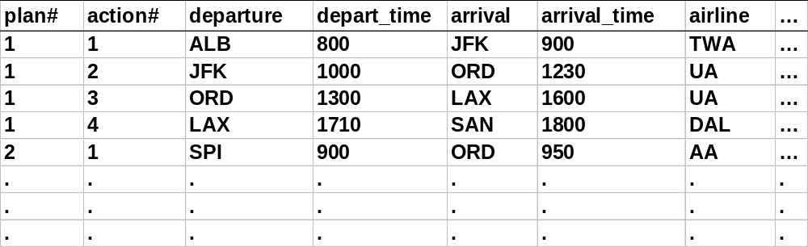
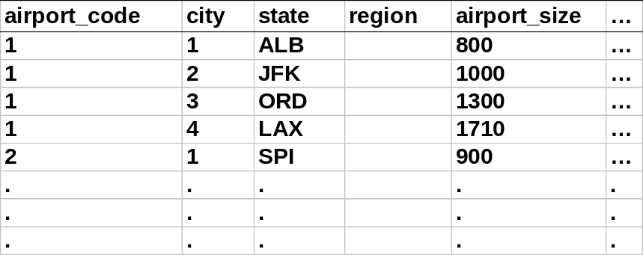
A Travel Database for Plan Mining
Example: Mining a travel planbase
Travel plans table
Airport info table

Slide 8
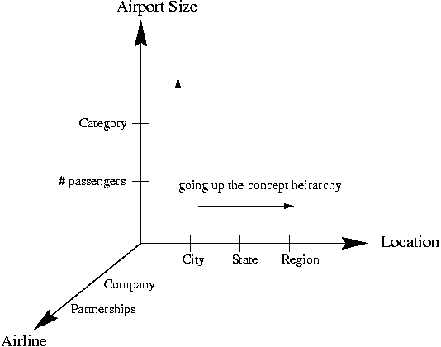
Multidimensional Analysis
Strategy
  Generalize the planbase in different directions
  Look for sequential patterns in the generalized plans
  Derive high-level plans
A multi-D model for the planbase

Slide 9
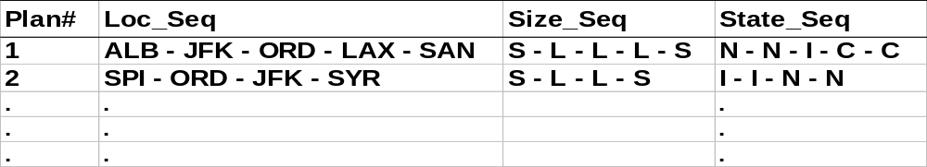
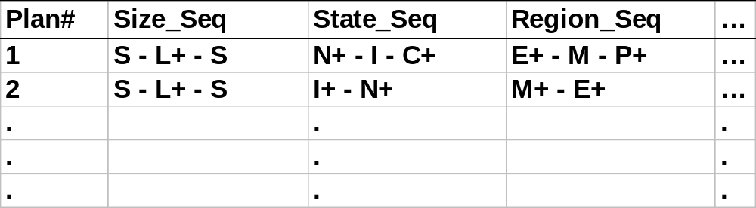
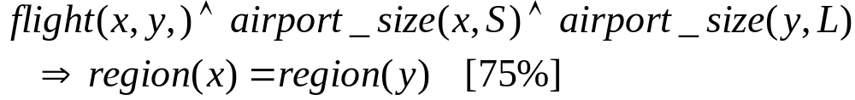
Multidimensional Generalization
Multi-D generalization of the planbase
Merging consecutive, identical actions in plans

Slide 10
Generalization-Based Sequence Mining
Generalize planbase in multidimensional way using dimension tables
Use # of distinct values (cardinality) at each level to determine the right level of generalization (level-“planning”)
Use operators merge “+”, option “[]” to further generalize patterns
Retain patterns with significant support

Slide 11
Generalized Sequence Patterns
AirportSize-sequence survives the min threshold (after applying merge operator):
  S-L⁺-S [35%], L⁺-S [30%], S-L⁺ [24.5%], L⁺ [9%]
After applying option operator:
  [S]-L⁺-[S] [98.5%]
  Most of the time, people fly via large airports to get to final destination
Other plans: 1.5% of chances, there are other patterns: S-S, L-S-L

Slide 12
Chapter 9. Mining Complex Types of Data
Multidimensional analysis and descriptive mining of complex data objects
Mining spatial databases
Mining multimedia databases
Mining time-series and sequence data
Mining text databases
Mining the World-Wide Web
Summary

Slide 13
Spatial Data Warehousing*
Spatial data warehouse: Integrated, subject-oriented, time-variant, and nonvolatile spatial data repository for data analysis and decision making
Spatial data integration: a big issue
  Structure-specific formats (raster- vs. vector-based, OO vs. relational models, different storage and indexing, etc.)
  Vendor-specific formats (ESRI, MapInfo, Integraph, etc.)
Spatial data cube: multidimensional spatial database
  Both dimensions and measures may contain spatial components

Slide 14
Dimensions and Measures in Spatial Data Warehouse*
Dimension modeling
  nonspatial
    e.g. temperature: 25-30 degrees generalizes to hot
  spatial-to-nonspatial
    e.g. region “B.C.” generalizes to description “western provinces”
  spatial-to-spatial
    e.g. region “Burnaby” generalizes to region “Lower Mainland”
Measures
  numerical
    distributive (e.g. count, sum)
    algebraic (e.g. average)
    holistic (e.g. median, rank)
  spatial
    collection of spatial pointers (e.g. pointers to all regions with 25-30 degrees in July)

Slide 15
Example: NE weather pattern analysis*
Input
  A map with about 3,000 weather probes scattered in B.C.
  Daily data for temperature, precipitation, wind velocity, etc.
  Concept hierarchies for all attributes
Output
  A map that reveals patterns: merged (similar) regions
Goals
  Interactive analysis (drill-down, slice, dice, pivot, roll-up)
  Fast response time
  Minimizing storage space used
Challenge
  A merged region may contain hundreds of “primitive” regions (polygons)

Slide 16
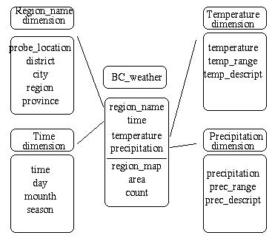
Star Schema of the BC Weather Warehouse
Spatial data warehouse
  Dimensions
    region_name
    time
    temperature
    precipitation
  Measurements
    region_map
    area
    count
Dimension table
Fact table

Slide 17
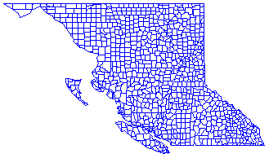
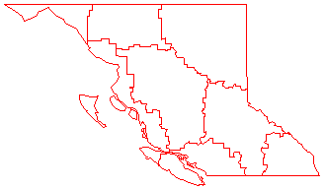
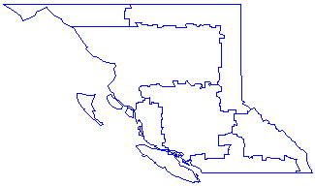
Spatial Merge*
  Precomputing all: too much storage space
  On-line merge: very expensive

Slide 18
Methods for Computation of Spatial Data Cube
On-line aggregation: collect and store pointers to spatial objects in a spatial data cube
  expensive and slow, need efficient aggregation techniques
Precompute and store all the possible combinations
  huge space overhead
Precompute and store rough approximations in a spatial data cube
  accuracy trade-off
Selective computation: only materialize those which will be accessed frequently
  a reasonable choice

Slide 19
Spatial Association Analysis*
Spatial association rule: A ⇒ B [s%, c%]
  A and B are sets of spatial or nonspatial predicates
    Topological relations: intersects, overlaps, disjoint, etc.
    Spatial orientations: left_of, west_of, under, etc.
    Distance information: close_to, within_distance, etc.
  s% is the support and c% is the confidence of the rule
Examples
is_a(x, large_town) ^ intersect(x, highway) → adjacent_to(x, water)
[7%, 85%]
is_a(x, large_town) ^adjacent_to(x, georgia_strait) → close_to(x, u.s.a.) [1%, 78%]

Slide 20
Progressive Refinement Mining of Spatial Association Rules
Hierarchy of spatial relationship:
  g_close_to: near_by, touch, intersect, contain, etc.
  First search for rough relationship and then refine it
Two-step mining of spatial association:
  Step 1: Rough spatial computation (as a filter)
    Using MBR or R-tree for rough estimation
  Step2: Detailed spatial algorithm (as refinement)
    Apply only to those objects which have passed the rough spatial association test (no less than min_support)

Slide 21
Spatial Classification and Spatial Trend Analysis*
Spatial classification
  Analyze spatial objects to derive classification schemes, such as decision trees in relevance to certain spatial properties (district, highway, river, etc.)
  Example: Classify regions in a province into rich vs. poor according to the average family income
Spatial trend analysis
  Detect changes and trends along a spatial dimension
  Study the trend of nonspatial or spatial data changing with space
  Example: Observe the trend of changes of the climate or vegetation with the increasing distance from an ocean

Slide 22
Chapter 9. Mining Complex Types of Data
Multidimensional analysis and descriptive mining of complex data objects
Mining spatial databases
Mining multimedia databases
Mining time-series and sequence data
Mining text databases
Mining the World-Wide Web
Summary

Slide 23
Similarity Search in Multimedia Data*
Description-based retrieval systems
  Build indices and perform object retrieval based on image descriptions, such as keywords, captions, size, and time of creation
  Labor-intensive if performed manually
  Results are typically of poor quality if automated
Content-based retrieval systems
  Support retrieval based on the image content, such as color histogram, texture, shape, objects, and wavelet transforms

Slide 24
Queries in Content-Based Retrieval Systems*
Image sample-based queries:
  Find all of the images that are similar to the given image sample
  Compare the feature vector (signature) extracted from the sample with the feature vectors of images that have already been extracted and indexed in the image database
Image feature specification queries:
  Specify or sketch image features like color, texture, or shape, which are translated into a feature vector
  Match the feature vector with the feature vectors of the images in the database

Slide 25
Approaches Based on Image Signature
Color histogram-based signature
  The signature includes color histograms based on color composition of an image regardless of its scale or orientation
  No information about shape, location, or texture
  Two images with similar color composition may contain very different shapes or textures, and thus could be completely unrelated in semantics
Multifeature composed signature
  The signature includes a composition of multiple features: color histogram, shape, location, and texture
  Can be used to search for similar images

Slide 26
Wavelet Analysis
Wavelet-based signature
  Use the dominant wavelet coefficients of an image as its signature
  Wavelets capture shape, texture, and location information in a single unified framework
  Improved efficiency and reduced the need for providing multiple search primitives
  May fail to identify images containing similar in location or size objects
Wavelet-based signature with region-based granularity
  Similar images may contain similar regions, but a region in one image could be a translation or scaling of a matching region in the other
  Compute and compare signatures at the granularity of regions, not the entire image

Slide 27
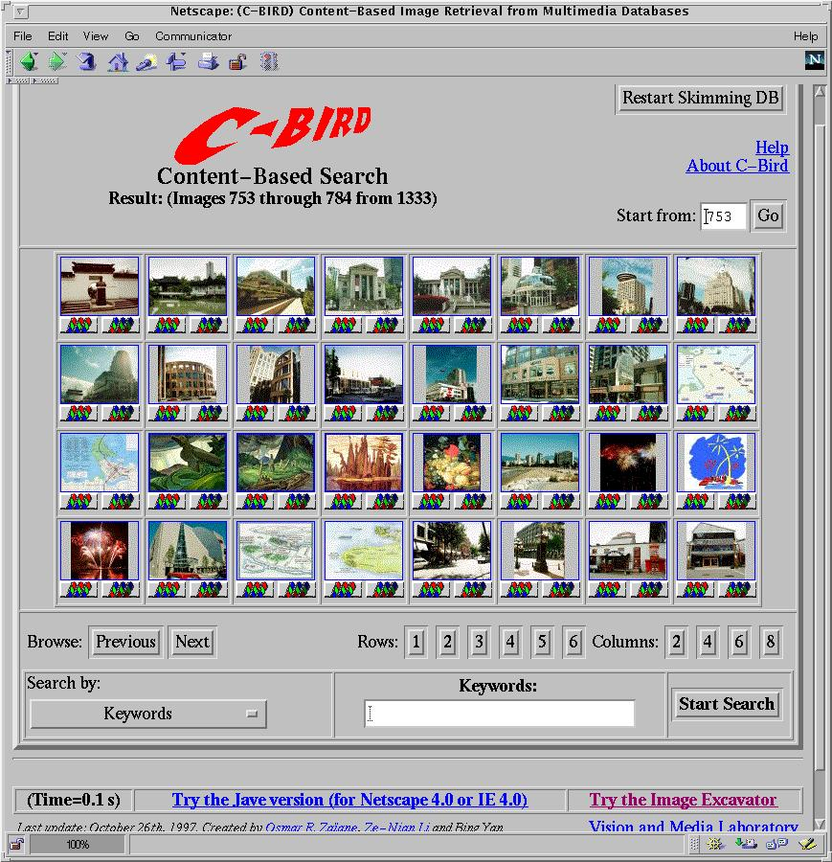
C-BIRD: Content-Based Image Retrieval from Digital libraries
Search
  by image colors
  by color percentage
  by color layout
  by texture density
  by texture Layout
  by object model
  by illumination invariance
  by keywords

Slide 28
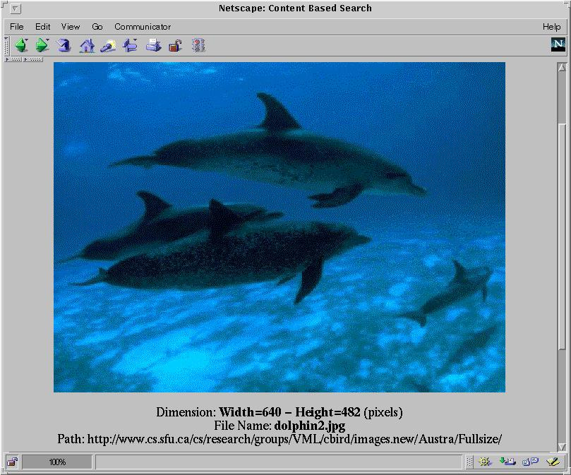
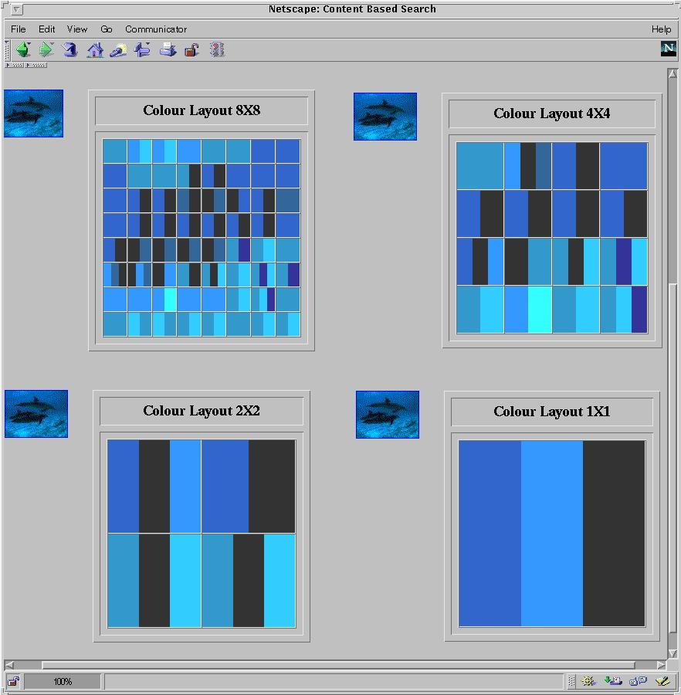
Multi-Dimensional Search in Multimedia Databases
Color layout

Slide 29
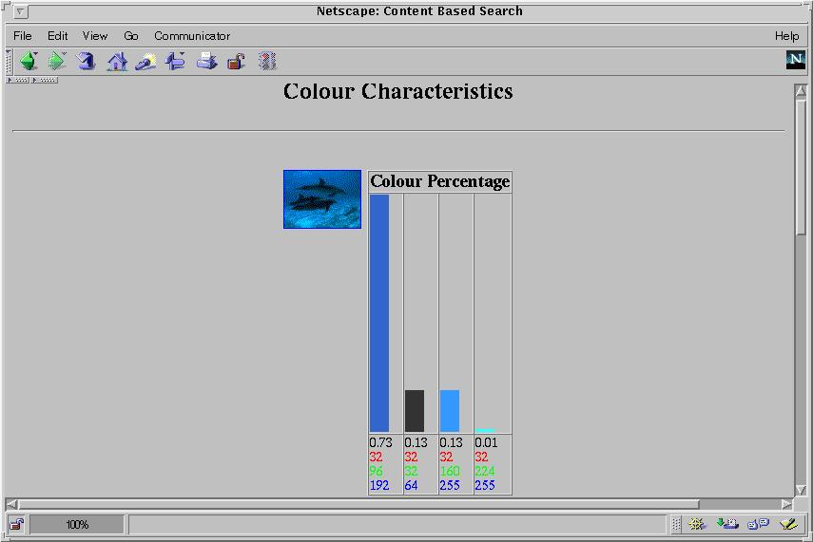
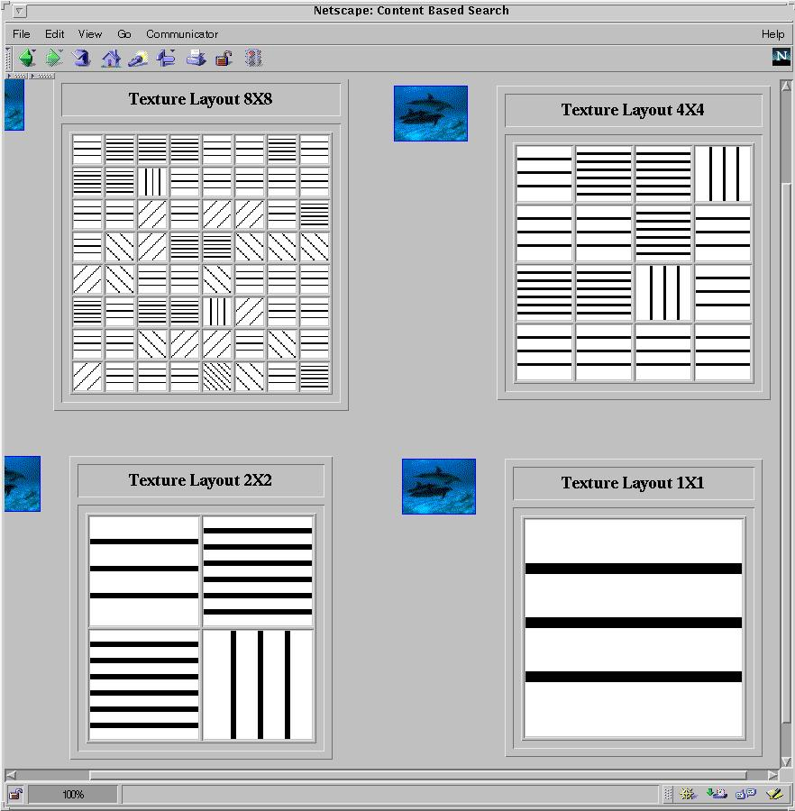
Multi-Dimensional Analysis in Multimedia Databases
Color histogram
Texture layout

Slide 30



Mining Multimedia Databases*
Refining or combining searches
Search for “airplane in blue sky”
(top layout grid is blue and
keyword = “airplane”)
Search for “blue sky and
green meadows”
(top layout grid is blue
and bottom is green)
Search for “blue sky”
(top layout grid is blue)

Slide 31
Multidimensional Analysis of Multimedia Data
Multimedia data cube
  Design and construction similar to that of traditional data cubes from relational data
  Contain additional dimensions and measures for multimedia information, such as color, texture, and shape
The database does not store images but their descriptors
  Feature descriptor: a set of vectors for each visual characteristic
    Color vector: contains the color histogram
    MFC (Most Frequent Color) vector: five color centroids
    MFO (Most Frequent Orientation) vector: five edge orientation centroids
  Layout descriptor: contains a color layout vector and an edge layout vector

Slide 32
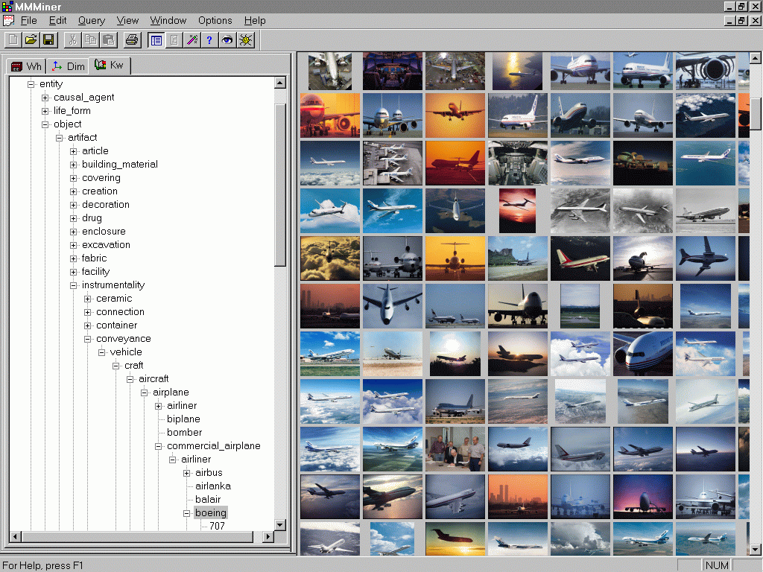
Mining Multimedia Databases in
*
MultiMediaMiner

Slide 33

Mining Multimedia Databases
Three Dimensions
The Data Cube and
the Sub-Space Measurements
JPEG
GIF
Small
Medium
Large
Very Large
Two Dimensions
By Size
By Format
By Format & Size
RED
WHITE
Cross Tab
BLUE
By Colour
By Colour & Size
By Format & Colour
JPEG
GIF
RED
Sum
By Colour
WHITE
BLUE
Format of image
Duration
Colors
Textures
Keywords
Size
Width
Height
Internet domain of image
Internet domain of parent pages
Image popularity
Group By
By Format
Colour
Sum
RED
WHITE
BLUE
Dimensions
Measurement
Sum

Slide 34
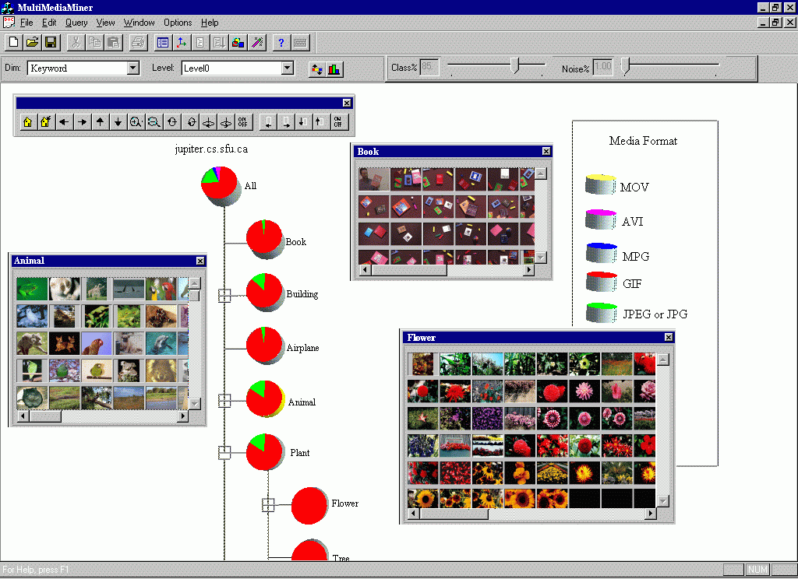
Classification in MultiMediaMiner

Slide 35
Mining Associations in Multimedia Data*
Special features:
  Need # of occurrences besides Boolean existence, e.g.,
    “Two red square and one blue circle” implies theme “air-show”
  Need spatial relationships
    Blue on top of white squared object is associated with brown bottom
  Need multi-resolution and progressive refinement mining
    It is expensive to explore detailed associations among objects at high resolution
    It is crucial to ensure the completeness of search at multi-resolution space

Slide 36
Mining Multimedia Databases*
Spatial Relationships from Layout
property P1 on-top-of property P2
property P1 next-to property P2
Different Resolution Hierarchy

Slide 37
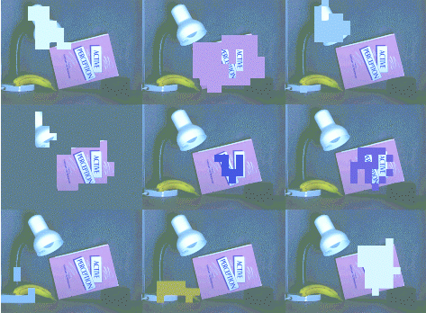

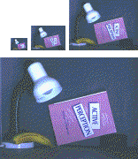
Mining Multimedia Databases*
From Coarse to Fine Resolution Mining

Slide 38
Challenge: Curse of Dimensionality*
Difficult to implement a data cube efficiently given a large number of dimensions, especially serious in the case of multimedia data cubes
Many of these attributes are set-oriented instead of single-valued
Restricting number of dimensions may lead to the modeling of an image at a rather rough, limited, and imprecise scale
More research is needed to strike a balance between efficiency and power of representation

Slide 39
Chapter 9. Mining Complex Types of Data
Multidimensional analysis and descriptive mining of complex data objects
Mining spatial databases
Mining multimedia databases
Mining time-series and sequence data
Mining text databases
Mining the World-Wide Web
Summary

Slide 40
Mining Time-Series and Sequence Data*
Time-series database
  Consists of sequences of values or events changing with time
  Data is recorded at regular intervals
  Characteristic time-series components
    Trend(general direction of the time series graph over a long interval of time), cycle(long term oscillation about the trend line), seasonal(due to festivals, etc.), irregular(due to natural calamities, labor disputes, etc.)
Applications :Financial: stock price, inflation. Biomedical: blood pressure. Meteorological:precipitation

Slide 41
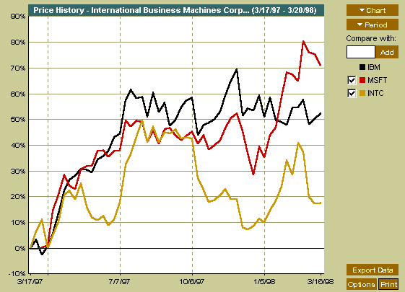
Mining Time-Series and Sequence Data*
Time-series plot

Slide 42
Mining Time-Series and Sequence Data: Trend analysis*
A time series can be illustrated as a time-series graph which describes a point moving with the passage of time
Categories of Time-Series Movements
  Long-term or trend movements (trend curve)
  Cyclic movements or cycle variations, e.g., business cycles
  Seasonal movements or seasonal variations
    i.e, almost identical patterns that a time series appears to follow during corresponding months of successive years.
  Irregular or random movements

Slide 43
Estimation of Trend Curve
The freehand method
  Fit the curve by looking at the graph
  Costly and barely reliable for large-scaled data mining
The least-square method
  Find the curve minimizing the sum of the squares of the deviation of points on the curve from the corresponding data points
The moving-average method
  Eliminate cyclic, seasonal and irregular patterns
  Loss of end data
  Sensitive to outliers

Slide 44
Discovery of Trend in Time-Series (1)
Estimation of seasonal variations
  Seasonal index
    Set of numbers showing the relative values of a variable during the months of the year
    E.g., if the sales during October, November, and December are 80%, 120%, and 140% of the average monthly sales for the whole year, respectively, then 80, 120, and 140 are seasonal index numbers for these months
  Deseasonalized data
    Data adjusted for seasonal variations
    E.g., divide the original monthly data by the seasonal index numbers for the corresponding months

Slide 45
Discovery of Trend in Time-Series (2)
Estimation of cyclic variations
  If (approximate) periodicity of cycles occurs, cyclic index can be constructed in much the same manner as seasonal indexes
Estimation of irregular variations
  By adjusting the data for trend, seasonal and cyclic variations
With the systematic analysis of the trend, cyclic, seasonal, and irregular components, it is possible to make long- or short-term predictions with reasonable quality

Slide 46
Similarity Search in Time-Series Analysis*
Normal database query finds exact match
Similarity search finds data sequences that differ only slightly from the given query sequence
Two categories of similarity queries
  Whole matching: find a sequence that is similar to the query sequence
  Subsequence matching: find all pairs of similar sequences
Typical Applications
  Financial market
  Market basket data analysis
  Scientific databases
  Medical diagnosis

Slide 47
Data transformation
Many techniques for signal analysis require the data to be in the frequency domain
Usually data-independent transformations are used
  The transformation matrix is determined a priori
    E.g., discrete Fourier transform (DFT), discrete wavelet transform (DWT)
  The distance between two signals in the time domain is the same as their Euclidean distance in the frequency domain
  DFT does a good job of concentrating energy in the first few coefficients
  If we keep only first a few coefficients in DFT, we can compute the lower bounds of the actual distance

Slide 48
Multidimensional Indexing
Multidimensional index
  Constructed for efficient accessing using the first few Fourier coefficients
Use the index can to retrieve the sequences that are at most a certain small distance away from the query sequence
Perform postprocessing by computing the actual distance between sequences in the time domain and discard any false matches

Slide 49
Subsequence Matching
Break each sequence into a set of pieces of window with length w
Extract the features of the subsequence inside the window
Map each sequence to a “trail” in the feature space
Divide the trail of each sequence into “subtrails” and represent each of them with minimum bounding rectangle
Use a multipiece assembly algorithm to search for longer sequence matches

Slide 50
Enhanced similarity search methods
Allow for gaps within a sequence or differences in offsets or amplitudes
Normalize sequences with amplitude scaling and offset translation
Two subsequences are considered similar if one lies within an envelope of ε width around the other, ignoring outliers
Two sequences are said to be similar if they have enough non-overlapping time-ordered pairs of similar subsequences
Parameters specified by a user or expert: sliding window size, width of an envelope for similarity, maximum gap, and matching fraction

Slide 51
Steps for performing a similarity search
Atomic matching
  Find all pairs of gap-free windows of a small length that are similar
Window stitching
  Stitch similar windows to form pairs of large similar subsequences allowing gaps between atomic matches
Subsequence Ordering
  Linearly order the subsequence matches to determine whether enough similar pieces exist

Slide 52
Query Languages for Time Sequences*
Time-sequence query language
  Should be able to specify sophisticated queries like
Find all of the sequences that are similar to some sequence in class A, but not similar to any sequence in class B
  Should be able to support various kinds of queries: range queries, all-pair queries, and nearest neighbor queries
Shape definition language
  Allows users to define and query the overall shape of time sequences
  Uses human readable series of sequence transitions or macros
  Ignores the specific details
    E.g., the pattern up, Up, UP can be used to describe increasing degrees of rising slopes
    Macros: spike, valley, etc.

Slide 53
Sequential Pattern Mining*
Mining of frequently occurring patterns related to time or other sequences
Sequential pattern mining usually concentrate on symbolic patterns
Examples
  Renting “Star Wars”, then “Empire Strikes Back”, then “Return of the Jedi” in that order
  Collection of ordered events within an interval
Applications
  Targeted marketing
  Customer retention
  Weather prediction

Slide 54
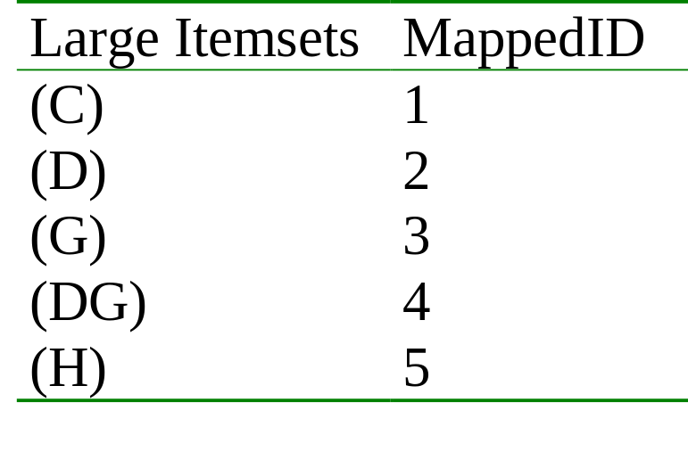
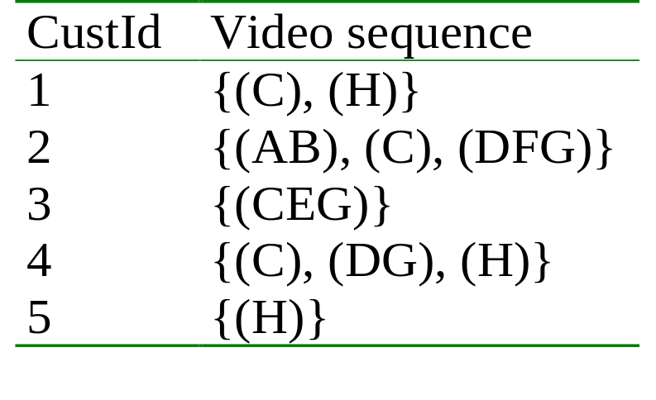
Mining Sequences (cont.)
Customer-sequence
Map Large Itemsets
Sequential patterns with support > 0.25
{(C), (H)}
{(C), (DG)}

Slide 55
Sequential pattern mining: Cases and Parameters
Duration of a time sequence T
  Sequential pattern mining can then be confined to the data within a specified duration
  Ex. Subsequence corresponding to the year of 1999
  Ex. Partitioned sequences, such as every year, or every week after stock crashes, or every two weeks before and after a volcano eruption
Event folding window w
  If w = T, time-insensitive frequent patterns are found
  If w = 0 (no event sequence folding), sequential patterns are found where each event occurs at a distinct time instant
  If 0 < w < T, sequences occurring within the same period w are folded in the analysis

Slide 56
Sequential pattern mining: Cases and Parameters (2)
Time interval, int, between events in the discovered pattern
  int = 0: no interval gap is allowed, i.e., only strictly consecutive sequences are found
    Ex. “Find frequent patterns occurring in consecutive weeks”
  min_int ≤ int ≤ max_int: find patterns that are separated by at least min_int but at most max_int
    Ex. “If a person rents movie A, it is likely she will rent movie B within 30 days” (int ≤ 30)
  int = c ≠ 0: find patterns carrying an exact interval
    Ex. “Every time when Dow Jones drops more than 5%, what will happen exactly two days later?” (int = 2)

Slide 57
Episodes and Sequential Pattern Mining Methods
Other methods for specifying the kinds of patterns
  Serial episodes: A → B
  Parallel episodes: A & B
  Regular expressions: (A | B)C*(D → E)
Methods for sequential pattern mining
  Variations of Apriori-like algorithms, e.g., GSP
  Database projection-based pattern growth
    Similar to the frequent pattern growth without candidate generation

Slide 58
Periodicity Analysis
Periodicity is everywhere: tides, seasons, daily power consumption, etc.
Full periodicity
  Every point in time contributes (precisely or approximately) to the periodicity
Partial periodicit: A more general notion
  Only some segments contribute to the periodicity
    Jim reads NY Times 7:00-7:30 am every week day
Cyclic association rules
  Associations which form cycles
Methods
  Full periodicity: FFT, other statistical analysis methods
  Partial and cyclic periodicity: Variations of Apriori-like mining methods

Slide 59
Chapter 9. Mining Complex Types of Data
Multidimensional analysis and descriptive mining of complex data objects
Mining spatial databases
Mining multimedia databases
Mining time-series and sequence data
Mining text databases
Mining the World-Wide Web
Summary

Slide 60
Text Databases and IR*
Text databases (document databases)
  Large collections of documents from various sources: news articles, research papers, books, digital libraries, e-mail messages, and Web pages, library database, etc.
  Data stored is usually semi-structured
  Traditional information retrieval techniques become inadequate for the increasingly vast amounts of text data
Information retrieval
  A field developed in parallel with database systems
  Information is organized into (a large number of) documents
  Information retrieval problem: locating relevant documents based on user input, such as keywords or example documents

Slide 61
Information Retrieval
Typical IR systems
  Online library catalogs
  Online document management systems
Information retrieval vs. database systems
  Some DB problems are not present in IR, e.g., update, transaction management, complex objects
  Some IR problems are not addressed well in DBMS, e.g., unstructured documents, approximate search using keywords and relevance

Slide 62
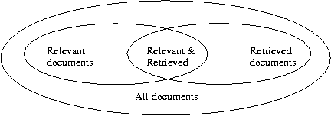
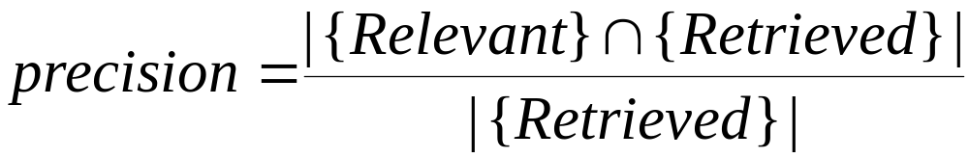
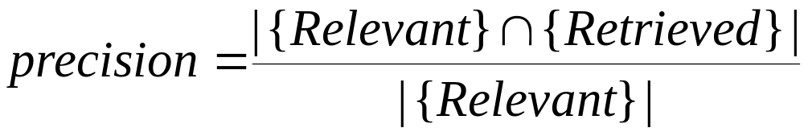
Basic Measures for Text Retrieval*
Precision: the percentage of retrieved documents that are in fact relevant to the query (i.e., “correct” responses)
Recall: the percentage of documents that are relevant to the query and were, in fact, retrieved

Slide 63
Keyword-Based Retrieval*
A document is represented by a string, which can be identified by a set of keywords
Queries may use expressions of keywords
  E.g., car and repair shop, tea or coffee, DBMS but not Oracle
  Queries and retrieval should consider synonyms, e.g., repair and maintenance
Major difficulties of the model
  Synonymy: A keyword T does not appear anywhere in the document, even though the document is closely related to T, e.g., data mining
  Polysemy: The same keyword may mean different things in different contexts, e.g., mining

Slide 64
Similarity-Based Retrieval in Text Databases*
Finds similar documents based on a set of common keywords
Answer should be based on the degree of relevance based on the nearness of the keywords, relative frequency of the keywords, etc.
Basic techniques
Stop list
    Set of words that are deemed “irrelevant”, even though they may appear frequently
    E.g., a, the, of, for, with, etc.
    Stop lists may vary when document set varies

Slide 65
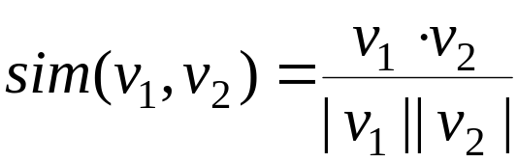
Similarity-Based Retrieval in Text Databases (2)*
  Word stem
    Several words are small syntactic variants of each other since they share a common word stem
    E.g., drug, drugs, drugged
  A term frequency table
    Each entry frequent_table(i, j) = # of occurrences of the word t_{i} in document d_{i}
    Usually, the ratio instead of the absolute number of occurrences is used
  Similarity metrics: measure the closeness of a document to a query (a set of keywords)
    Relative term occurrences
    Cosine distance:

Slide 66
Latent Semantic Indexing
Basic idea
  Similar documents have similar word frequencies
  Difficulty: the size of the term frequency matrix is very large
  Use a singular value decomposition (SVD) techniques to reduce the size of frequency table
  Retain the K most significant rows of the frequency table
Method
  Create a term frequency matrix, freq_matrix
  SVD construction: Compute the singular valued decomposition of freq_matrix by splitting it into 3 matrices, U, S, V
  Vector identification: For each document d, replace its original document vector by a new excluding the eliminated terms
  Index creation: Store the set of all vectors, indexed by one of a number of techniques (such as TV-tree)

Slide 67
Other Text Retrieval Indexing Techniques
Inverted index
  Maintains two hash- or B+-tree indexed tables:
    document_table: a set of document records <doc_id, postings_list>
    term_table: a set of term records, <term, postings_list>
  Answer query: Find all docs associated with one or a set of terms
  Advantage: easy to implement
  Disadvantage: do not handle well synonymy and polysemy, and posting lists could be too long (storage could be very large)
Signature file
  Associate a signature with each document
  A signature is a representation of an ordered list of terms that describe the document
  Order is obtained by frequency analysis, stemming and stop lists

Slide 68
Types of Text Data Mining*
Keyword-based association analysis: Collect sets of keywords or terms that occur frequently together and then find the association or correlation relationships among them
Automatic document classification(Physics docs, Chemistry docs, Data mining docs, etc.): For classification of new/unkown documents.
Similarity detection
  Cluster documents by a common author
  Cluster documents containing information from a common source
Link analysis: unusual correlation between entities
Sequence analysis: predicting a recurring event
Anomaly detection: find information that violates usual patterns
Hypertext analysis
  Patterns in anchors/links
    Anchor text correlations with linked objects

Slide 69
Keyword-based association analysis
Collect sets of keywords or terms that occur frequently together and then find the association or correlation relationships among them
First preprocess the text data by parsing, stemming, removing stop words, etc.
Then evoke association mining algorithms
  Consider each document as a transaction
  View a set of keywords in the document as a set of items in the transaction
Term level association mining
  No need for human effort in tagging documents
  The number of meaningless results and the execution time is greatly reduced

Slide 70
Automatic document classification
Motivation
  Automatic classification for the tremendous number of on-line text documents (Web pages, e-mails, etc.)
A classification problem
  Training set: Human experts generate a training data set
  Classification: The computer system discovers the classification rules
  Application: The discovered rules can be applied to classify new/unknown documents
Text document classification differs from the classification of relational data
  Document databases are not structured according to attribute-value pairs

Slide 71
Association-Based Document Classification
Extract keywords and terms by information retrieval and simple association analysis techniques
Obtain concept hierarchies of keywords and terms using
  Available term classes, such as WordNet
  Expert knowledge
  Some keyword classification systems
Classify documents in the training set into class hierarchies
Apply term association mining method to discover sets of associated terms
Use the terms to maximally distinguish one class of documents from others
Derive a set of association rules associated with each document class
Order the classification rules based on their occurrence frequency and discriminative power
Used the rules to classify new documents

Slide 72
Document Clustering*
Automatically group related documents based on their contents
Require no training sets or predetermined taxonomies, generate a taxonomy at runtime
Major steps
  Preprocessing
    Remove stop words, stem, feature extraction, lexical analysis, …
  Hierarchical clustering
    Compute similarities applying clustering algorithms, …
  Slicing
    Fan out controls, flatten the tree to configurable number of levels, …

Slide 73
Chapter 9. Mining Complex Types of Data
Multidimensional analysis and descriptive mining of complex data objects
Mining spatial databases
Mining multimedia databases
Mining time-series and sequence data
Mining text databases
Mining the World-Wide Web
Summary

Slide 74
Mining the World-Wide Web*
The WWW is huge, widely distributed, global information service center for
  Information services: news, advertisements, consumer information, financial management, education, government, e-commerce, etc.
  Hyper-link information
  Access and usage information
WWW provides rich sources for data mining
Challenges
  Too huge for effective data warehousing and data mining
  Too complex and heterogeneous: no standards and structure

Slide 75
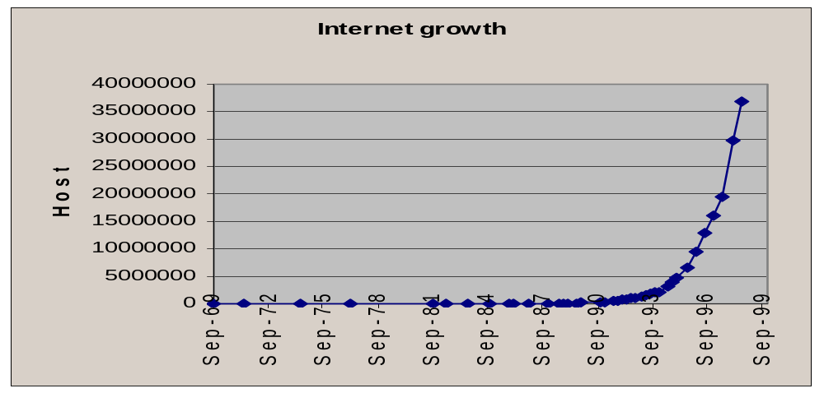
Mining the World-Wide Web*
Growing and changing very rapidly
Broad diversity of user communities
Only a small portion of the information on the Web is truly relevant or useful
  99% of the Web information is useless to 99% of Web users
  How can we find high-quality Web pages on a specified topic?

Slide 76
Web search engines
Index-based: search the Web, index Web pages, and build and store huge keyword-based indices
Help locate sets of Web pages containing certain keywords
Deficiencies
  A topic of any breadth may easily contain hundreds of thousands of documents
  Many documents that are highly relevant to a topic may not contain keywords defining them (polysemy)

Slide 77
Web Mining: A more challenging task*
Searches for
  Web access patterns
  Web structures
  Regularity and dynamics of Web contents
Problems
  The “abundance” problem
  Limited coverage of the Web: hidden Web sources, majority of data in DBMS
  Limited query interface based on keyword-oriented search
  Limited customization to individual users

Slide 78
Web Mining Taxonomy*
Web Mining
Web Content
Mining
Web Structure
Mining
Web Usage
Mining
Web Page
Content Mining
Search Result
Mining
General Access
Pattern Tracking
Customized
Usage Tracking

Slide 79
Mining the World-Wide Web*
Web Mining
Web Content
Mining
Web Structure
Mining
Web Usage
Mining
Web Page Content Mining
Web Page Summarization
WebLog (Lakshmanan et.al. 1996), WebOQL(Mendelzon et.al. 1998) …:
Web Structuring query languages;
Can identify information within given web pages
Ahoy! (Etzioni et.al. 1997):Uses heuristics to distinguish personal home pages from other web pages
ShopBot (Etzioni et.al. 1997): Looks for product prices within web pages
Search Result
Mining
General Access
Pattern Tracking
Customized
Usage Tracking

Slide 80
Mining the World-Wide Web*
Web Mining
Web Content
Mining
Web Structure
Mining
Web Usage
Mining
Web Page
Content Mining
Search Result Mining
Search Engine Result Summarization
Clustering Search Result (Leouski and Croft, 1996, Zamir and Etzioni, 1997):
Categorizes documents using phrases in titles and snippets
General Access
Pattern Tracking
Customized
Usage Tracking

Slide 81
Mining the World-Wide Web*
Web Mining
Web Content
Mining
Web Usage
Mining
Web Structure Mining
Using Links
PageRank (Brin et al., 1998)
CLEVER (Chakrabarti et al., 1998)
Use interconnections between web pages to give weight to pages.
Using Generalization
MLDB (1994), VWV (1998)
Uses a multi-level database representation of the Web. Counters (popularity) and link lists are used for capturing structure.
Search Result
Mining
General Access
Pattern Tracking
Web Page
Content Mining
Customized
Usage Tracking

Slide 82
Mining the World-Wide Web*
Web Mining
Web Content
Mining
Web Structure
Mining
Web Usage
Mining
Web Page
Content Mining
General Access Pattern Tracking
Web Log Mining (Zaïane, Xin and Han, 1998)
Uses KDD techniques to understand general access patterns and trends.
Can shed light on better structure and grouping of resource providers.
Customized/Individual
Usage Tracking
Search Result
Mining

Slide 83
Mining the World-Wide Web*
Web Mining
Web Content
Mining
Web Structure
Mining
Web Usage
Mining
Web Page
Content Mining
General Access
Pattern Tracking
Customized Usage Tracking
Adaptive Sites (Perkowitz and Etzioni, 1997)
Analyzes access patterns of each user at a time.
Web site restructures itself automatically by learning from user access patterns.
Search Result
Mining

Slide 84
Mining the Web's Link Structures*
Finding authoritative(highly relevant and quality) Web pages
  Retrieving pages that are not only relevant, but also of high quality, or authoritative on the topic
Hyperlinks can infer the notion of authority
  The Web consists not only of pages, but also of hyperlinks pointing from one page to another
  These hyperlinks contain an enormous amount of latent human annotation
  A hyperlink pointing to another Web page, this can be considered as the author's endorsement of the other page

Slide 85
Mining the Web's Link Structures
Problems with the Web linkage structure
  Not every hyperlink represents an endorsement
    Other purposes are for navigation or for paid advertisements
    If the majority of hyperlinks are for endorsement, the collective opinion will still dominate
  One authority will seldom have its Web page point to its rival authorities in the same field
  Authoritative pages are seldom particularly descriptive
Hub
  Set of Web pages that provides collections of links to authorities

Slide 86
HITS (Hyperlink-Induced Topic Search)
Explore interactions between hubs and authoritative pages
Use an index-based search engine to form the root set
  Many of these pages are presumably relevant to the search topic
  Some of them should contain links to most of the prominent authorities
Expand the root set into a base set
  Include all of the pages that the root-set pages link to, and all of the pages that link to a page in the root set, up to a designated size cutoff
Apply weight-propagation
  An iterative process that determines numerical estimates of hub and authority weights

Slide 87
Systems Based on HITS
  Output a short list of the pages with large hub weights, and the pages with large authority weights for the given search topic
Systems based on the HITS algorithm
  Clever, Google: achieve better quality search results than those generated by term-index engines such as AltaVista and those created by human ontologists such as Yahoo!
Difficulties from ignoring textual contexts
  Drifting: when hubs contain multiple topics
  Topic hijacking: when many pages from a single Web site point to the same single popular site

Slide 88
Automatic Classification of Web Documents*
Assign a class label to each document from a set of predefined topic categories
Based on a set of examples of preclassified documents
Example
  Use Yahoo!'s taxonomy and its associated documents as training and test sets
  Derive a Web document classification scheme
  Use the scheme classify new Web documents by assigning categories from the same taxonomy
Keyword-based document classification methods
Statistical models

Slide 89
Multilayered Web Information Base
Layer₀: the Web itself
Layer₁: the Web page descriptor layer
  Contains descriptive information for pages on the Web
  An abstraction of Layer₀: substantially smaller but still rich enough to preserve most of the interesting, general information
  Organized into dozens of semistructured classes
    document, person, organization, ads, directory, sales, software, game, stocks, library_catalog, geographic_data, scientific_data, etc.
Layer₂ and up: various Web directory services constructed on top of Layer₁
  provide multidimensional, application-specific services

Slide 90







Multiple Layered Web Architecture
More Generalized Descriptions
Layer_{n}
...
Generalized Descriptions
Layer₁
Layer₀

Slide 91
Mining the World-Wide Web
Layer-0: Primitive data
Layer-1: dozen database relations representing types of objects (metadata)
document, organization, person, software, game, map, image,…
document(file_addr, authors, title, publication, publication_date, abstract, language, table_of_contents, category_description, keywords, index, multimedia_attached, num_pages, format, first_paragraphs, size_doc, timestamp, access_frequency, links_out,...)
person(last_name, first_name, home_page_addr, position, picture_attached, phone, e-mail, office_address, education, research_interests, publications, size_of_home_page, timestamp, access_frequency, ...)
image(image_addr, author, title, publication_date, category_description, keywords, size, width, height, duration, format, parent_pages, colour_histogram, Colour_layout, Texture_layout, Movement_vector, localisation_vector, timestamp, access_frequency, ...)

Slide 92
Mining the World-Wide Web
Layer-2: simplification of layer-1
doc_brief(file_addr, authors, title, publication, publication_date, abstract, language, category_description, key_words, major_index, num_pages, format, size_doc, access_frequency, links_out)
person_brief (last_name, first_name, publications,affiliation, e-mail, research_interests, size_home_page, access_frequency)
Layer-3: generalization of layer-2
cs_doc(file_addr, authors, title, publication, publication_date, abstract, language, category_description, keywords, num_pages, form, size_doc, links_out)
doc_summary(affiliation, field, publication_year, count, first_author_list, file_addr_list)
doc_author_brief(file_addr, authors, affiliation, title, publication, pub_date, category_description, keywords, num_pages, format, size_doc, links_out)
person_summary(affiliation, research_interest, year, num_publications, count)

Slide 93
XML and Web Mining
XML can help to extract the correct descriptors
  Standardization would greatly facilitate information extraction
  Potential problem
    XML can help solve heterogeneity for vertical applications, but the freedom to define tags can make horizontal applications on the Web more heterogeneous
<NAME> eXtensible Markup Language</NAME>
<RECOM>World-Wide Web Consortium</RECOM>
<SINCE>1998</SINCE>
<VERSION>1.0</VERSION>
<DESC>Meta language that facilitates more meaningful and precise declarations of document content</DESC>
<HOW>Definition of new tags and DTDs</HOW>

Slide 94
Benefits of Multi-Layer Meta-Web
Benefits:
  Multi-dimensional Web info summary analysis
  Approximate and intelligent query answering
  Web high-level query answering (WebSQL, WebML)
  Web content and structure mining
  Observing the dynamics/evolution of the Web
Is it realistic to construct such a meta-Web?
  Benefits even if it is partially constructed
  Benefits may justify the cost of tool development, standardization and partial restructuring

Slide 95
Web Usage Mining*
Mining Web log records to discover user access patterns of Web pages
Applications
  Cyber crime.
  Target potential customers for electronic commerce
  Enhance the quality and delivery of Internet information services to the end user
  Improve Web server system performance
  Identify potential prime advertisement locations
Web logs provide rich information about Web dynamics
  Typical Web log entry includes the URL requested, the IP address from which the request originated, and a timestamp

Slide 96
Techniques for Web usage mining
Construct multidimensional view on the Weblog database
  Perform multidimensional OLAP analysis to find the top N users, top N accessed Web pages, most frequently accessed time periods, etc.
Perform data mining on Weblog records
  Find association patterns, sequential patterns, and trends of Web accessing
  May need additional information,e.g., user browsing sequences of the Web pages in the Web server buffer
Conduct studies to
  Analyze system performance, improve system design by Web caching, Web page prefetching, and Web page swapping

Slide 97




Mining the World-Wide Web*
Design of a Web Log Miner
  Web log is filtered to generate a relational database
  A data cube is generated form database
  OLAP is used to drill-down and roll-up in the cube
  OLAM is used for mining interesting knowledge
Knowledge
Web log
Database
Data Cube
Sliced and diced
cube
1
Data Cleaning
2
Data Cube
Creation
3
OLAP
4
Data Mining

Slide 98
Chapter 9. Mining Complex Types of Data
Multidimensional analysis and descriptive mining of complex data objects
Mining spatial databases
Mining multimedia databases
Mining time-series and sequence data
Mining text databases
Mining the World-Wide Web
Summary

Slide 99
Summary (1)
Mining complex types of data include object data, spatial data, multimedia data, time-series data, text data, and Web data
Object data can be mined by multi-dimensional generalization of complex structured data, such as plan mining for flight sequences
Spatial data warehousing, OLAP and mining facilitates multidimensional spatial analysis and finding spatial associations, classifications and trends
Multimedia data mining needs content-based retrieval and similarity search integrated with mining methods

Slide 100
Summary (2)
Time-series/sequential data mining includes trend analysis, similarity search in time series, mining sequential patterns and periodicity in time sequence
Text mining goes beyond keyword-based and similarity-based information retrieval and discovers knowledge from semi-structured data using methods like keyword-based association and document classification
Web mining includes mining Web link structures to identify authoritative Web pages, the automatic classification of Web documents, building a multilayered Web information base, and Weblog mining

Slide 101
References (1)
R. Agrawal, C. Faloutsos, and A. Swami. Efficient similarity search in sequence databases. In Proc. 4th Int. Conf. Foundations of Data Organization and Algorithms, Chicago, Oct. 1993.
R. Agrawal, K.-I. Lin, H.S. Sawhney, and K. Shim. Fast similarity search in the presence of noise, scaling, and translation in time-series databases. VLDB'95, Zurich, Switzerland, Sept. 1995.
G. Arocena and A. O. Mendelzon. WebOQL : Restructuring documents, databases, and webs. ICDE'98, Orlando, FL, Feb. 1998.
R. Agrawal, G. Psaila, E. L. Wimmers, and M. Zait. Querying shapes of histories. VLDB'95, Zurich, Switzerland, Sept. 1995.
R. Agrawal and R. Srikant. Mining sequential patterns. ICDE'95, Taipei, Taiwan, Mar. 1995.
S. Brin and L. Page. The anatomy of a large-scale hypertextual web search engine. WWW'98, Brisbane, Australia, 1998.
C. Bettini, X. Sean Wang, and S. Jajodia. Mining temporal relationships with multiple granularities in time sequences. Data Engineering Bulletin, 21:32-38, 1998.
R. Baeza-Yates and B. Ribeiro-Neto. Modern Information Retrieval. Addison-Wesley, 1999.
S. Chakrabarti, B. E. Dom, and P. Indyk. Enhanced hypertext classification using hyper-links. SIGMOD'98, Seattle, WA, June 1998.
S. Chakrabarti, B. E. Dom, S. R. Kumar, P. Raghavan, S. Rajagopalan, A. Tomkins, D. Gibson, and J. M. Kleinberg. Mining the web's link structure. COMPUTER, 32:60-67, 1999.

Slide 102
References (2)
J. Chen, D. DeWitt, F. Tian, and Y. Wang. NiagraCQ: A scalable continuous query system for internet databases. SIGMOD'00, Dallas, TX, May 2000.
C. Chatfield. The Analysis of Time Series: An Introduction, 3rd ed. Chapman and Hall, 1984.
S. Chakrabarti. Data mining for hypertex: A tutorial survey. SIGKDD Explorations, 1:1-11, 2000.
S. Deerwester, S. Dumais, G. Furnas, T. Landauer, and R. Harshman. Indexing by latent semantic analysis. J. American Society for Information Science, 41:391-407, 1990.
M. Ester, A. Frommelt, H.-P. Kriegel, and J. Sander. Algorithms for claracterization and trend detection in spatial databases. KDD'98, New York, NY, Aug. 1998.
M.J. Egenhofer. Spatial Query Languages. UMI Research Press, University of Maine, Portland, Maine, 1989.
M. Ester, H.-P. Kriegel, and J. Sander. Spatial data mining: A database approach. SSD'97, Berlin, Germany, July 1997.
C. Faloutsos. Access methods for text. ACM Comput. Surv., 17:49-74, 1985.
U. M. Fayyad, S. G. Djorgovski, and N. Weir. Automating the analysis and cataloging of sky surveys. In U.M. Fayyad, G. Piatetsky-Shapiro, P. Smyth, and R. Uthurusamy, editors, Advances in Knowledge Discovery and Data Mining, AAAI/MIT Press, 1996.
R. Feldman and H. Hirsh. Finding associations in collectionds of text. In R. S. Michalski, I. Bratko, and M. Kubat, editors, "Machine Learning and Data Mining: Methods and Applications", John Wiley Sons, 1998.

Slide 103
References (3)
C. Faloutsos and K.-I. Lin. FastMap: A fast algorithm for indexing, data-mining and visualization of traditional and multimedia datasets. SIGMOD'95, San Jose, CA, May 1995.
D. Florescu, A. Y. Levy, and A. O. Mendelzon. Database techniques for the world-wide web: A survey. SIGMOD Record, 27:59-74, 1998.
U. M. Fayyad, G. Piatetsky-Shapiro, P. Smyth, and R. Uthurusamy (eds.). Advances in Knowledge Discovery and Data Mining. AAAI/MIT Press, 1996.
C. Faloutsos, M. Ranganathan, and Y. Manolopoulos. Fast subsequence matching in time-series databases. SIGMOD'94, Minneapolis, Minnesota, May 1994.
M. Flickner, H. Sawhney, W. Niblack, J. Ashley, B. Dom, Q. Huang, M. Gorkani, J. Hafner, D. Lee, D. Petkovic, S. Steele, and P. Yanker. Query by image and video content: The QBIC system. IEEE Computer, 28:23-32, 1995.
S. Guha, R. Rastogi, and K. Shim. Rock: A robust clustering algorithm for categorical attributes. ICDE'99, Sydney, Australia, Mar. 1999.
R. H. Gueting. An introduction to spatial database systems. The VLDB Journal, 3:357-400, 1994.
J. Han, G. Dong, and Y. Yin. Efficient mining of partial periodic patterns in time series database. ICDE'99, Sydney, Australia, Apr. 1999.
J. Han, K. Koperski, and N. Stefanovic. GeoMiner: A system prototype for spatial data mining. SIGMOD'97, Tucson, Arizona, May 1997.

Slide 104
References (4)
J. Han, S. Nishio, H. Kawano, and W. Wang. Generalization-based data mining in object-oriented databases using an object-cube model. Data and Knowledge Engineering, 25:55-97, 1998.
J. Han, J. Pei, B. Mortazavi-Asl, Q. Chen, U. Dayal, and M.-C. Hsu. Freespan: Frequent pattern-projected sequential pattern mining. KDD'00, Boston, MA, Aug. 2000.
J. Han, N. Stefanovic, and K. Koperski. Selective materialization: An efficient method for spatial data cube construction. PAKDD'98. Melbourne, Australia, Apr. 1998.
J. Han, Q. Yang, and E. Kim. Plan mining by divide-and-conquer. DMKD'99, Philadelphia, PA, May 1999.
K. Koperski and J. Han. Discovery of spatial association rules in geographic information databases. SSD'95, Portland, Maine, Aug. 1995.
J. M. Kleinberg. Authoritative sources in a hyperlinked environment. Journal of ACM, 46:604-632, 1999.
E. Knorr and R. Ng. Finding aggregate proximity relationships and commonalities in spatial data mining. IEEE Trans. Knowledge and Data Engineering, 8:884-897, 1996.
J. M. Kleinberg and A. Tomkins. Application of linear algebra in information retrieval and hypertext analysis. PODS'99. Philadelphia, PA, May 1999.
H. Lu, J. Han, and L. Feng. Stock movement and n-dimensional inter-transaction association rules. DMKD'98, Seattle, WA, June 1998.

Slide 105
References (5)
W. Lu, J. Han, and B. C. Ooi. Knowledge discovery in large spatial databases. In Proc. Far East Workshop Geographic Information Systems, Singapore, June 1993.
D. J. Maguire, M. Goodchild, and D. W. Rhind. Geographical Information Systems: Principles and Applications. Longman, London, 1992.
H. Miller and J. Han. Geographic Data Mining and Knowledge Discovery. Taylor and Francis, 2000.
A. O. Mendelzon, G. A. Mihaila, and T. Milo. Querying the world-wide web. Int. Journal of Digital Libraries, 1:54-67, 1997.
H. Mannila, H Toivonen, and A. I. Verkamo. Discovery of frequent episodes in event sequences. Data Mining and Knowledge Discovery, 1:259-289, 1997.
A. Natsev, R. Rastogi, and K. Shim. Walrus: A similarity retrieval algorithm for image databases. SIGMOD'99, Philadelphia, PA, June 1999.
B. Ozden, S. Ramaswamy, and A. Silberschatz. Cyclic association rules. ICDE'98, Orlando, FL, Feb. 1998.
M. Perkowitz and O. Etzioni. Adaptive web sites: Conceptual cluster mining. IJCAI'99, Stockholm, Sweden, 1999.
P. Raghavan. Information retrieval algorithms: A survey. In Proc. 1997 ACM-SIAM Symp. Discrete Algorithms, New Orleans, Louisiana, 1997.

Slide 106
References (6)
D. Rafiei and A. Mendelzon. Similarity-based queries for time series data. SIGMOD'97, Tucson, Arizona, May 1997.
G. Salton. Automatic Text Processing. Addison-Wesley, 1989.
J. Srivastava, R. Cooley, M. Deshpande, and P. N. Tan. Web usage mining: Discovery and applications of usage patterns from web data. SIGKDD Explorations, 1:12-23, 2000.
P. Stolorz and C. Dean. Quakefinder: A scalable data mining system for detecting earthquakes from space. KDD'96, Portland, Oregon, Aug. 1996.
G. Salton and M. McGill. Introduction to Modern Information Retrieval. McGraw-Hill, 1983.
V. S. Subrahmanian. Principles of Multimedia Database Systems. Morgan Kaufmann, 1998.
C. J. van Rijsbergen. Information Retrieval. Butterworth, 1990.
K. Wang, S. Zhou, and S. C. Liew. Building hierarchical classifiers using class proximity. VLDB'99, Edinburgh, UK, Sept. 1999.
B.-K. Yi, H. V. Jagadish, and C. Faloutsos. Efficient retrieval of similar time sequences under time warping. ICDE'98, Orlando, FL, Feb. 1998.
C. T. Yu and W. Meng. Principles of Database Query Processing for Advanced Applications. Morgan Kaufmann, 1997.

Slide 107
References (7)
B.-K. Yi, N. Sidiropoulos, T. Johnson, H. V. Jagadish, C. Faloutsos, and A. Biliris. Online data mining for co-evolving time sequences. ICDE'00, San Diego, CA, Feb. 2000.
C. Zaniolo, S. Ceri, C. Faloutsos, R. T. Snodgrass, C. S. Subrahmanian, and R. Zicari. Advanced Database Systems. Morgan Kaufmann, 1997.
O. R. Za"iane and J. Han. Resource and knowledge discovery in global information systems: A preliminary design and experiment. KDD'95, Montreal, Canada, Aug. 1995.
O. R. Za"iane and J. Han. WebML : Querying the world-wide web for resources and knowledge. WIDM'98, Bethesda, Maryland, Nov. 1998.
O. R. Za"iane, J. Han, Z. N. Li, J. Y. Chiang, and S. Chee. MultiMedia-Miner: A system prototype for multimedia data mining. SIGMOD'98, Seattle, WA, June 1998.
O. R. Za"iane, J. Han, and H. Zhu. Mining recurrent items in multimedia with progressive resolution refinement. ICDE'00, San Diego, CA, Feb. 2000.
M. J. Zaki, N. Lesh, and M. Ogihara. PLANMINE: Sequence mining for plan failures. KDD'98, New York, NY, Aug. 1998.
X. Zhou, D. Truffet, and J. Han. Efficient polygon amalgamation methods for spatial OLAP and spatial data mining. SSD'99. Hong Kong, July 1999.
O. R. Za"iane, M. Xin, and J. Han. Discovering Webaccess patterns and trends by applying OLAP and data mining technology on Web logs. ADL'98, Santa Barbara, CA, Apr. 1998.

Slide 108

http://www.cs.sfu.ca/~han/dmbook
Thank you !!!

